Slide 1


JUNE 2024
HOTEL RESERVATION
PROJECT
Analysis with SQL
Presented by Abdullah Farid

Slide 2
TABLE
of contents
01. Overview
03. Analysis
02. Dataset Details
04. Conclusion

Slide 3


Overview
The hotel industry relies on data to make informed decisions and provide a better guest experience. I have worked with a hotel reservation dataset to gain insights into guest preferences, booking trends, and other key factors that impact the hotel's operations. I have used SQL to query and analyze the data, as well as answer specific questions about the dataset.

Slide 4

Dataset Details
Booking_ID: A unique identifier for each hotel reservation.
no_of_adults: The number of adults in the reservation.
no_of_children: The number of children in the reservation.
no_of_weekend_nights: The number of nights in the reservation that fall on weekends.
no_of_week_nights: The number of nights in the reservation that fall on weekdays.

Slide 5
type_of_meal_plan: The meal plan chosen by the guests.
room_type_reserved: The type of room reserved by the guests.
lead_time: The number of days between booking and arrival.
arrival_date: The date of arrival.
market_segment_type: The market segment to which the reservation belongs.
avg_price_per_room: The average price per room in the reservation.
booking_status: The status of the booking.

Slide 6
Analysis
Question
Code
Output
Questions given to extract insights from
SQL used to answer the question
The result query that has been created after executing the code

Slide 7
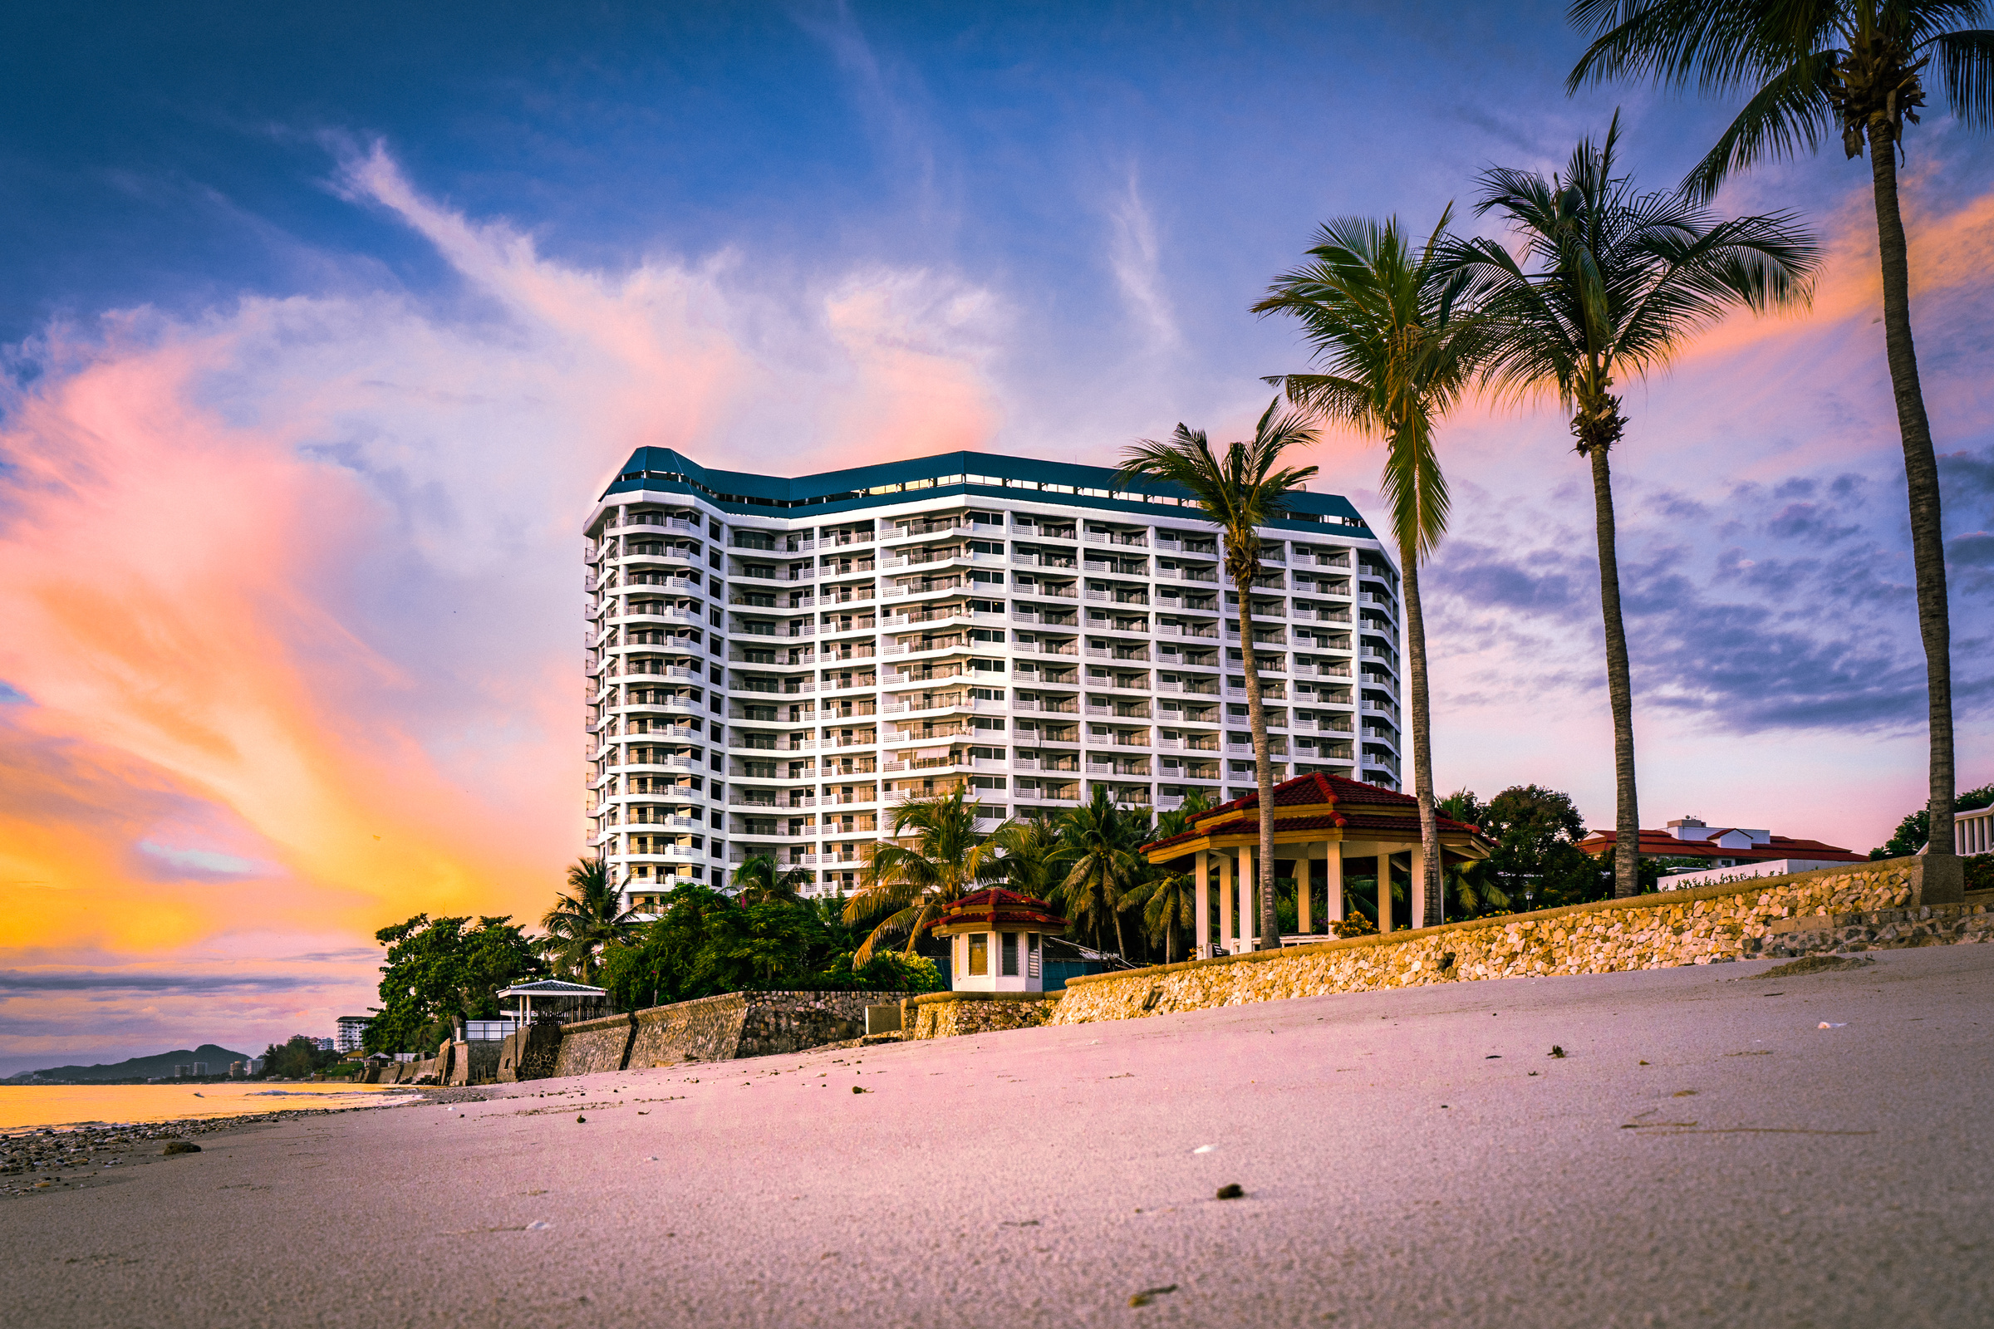
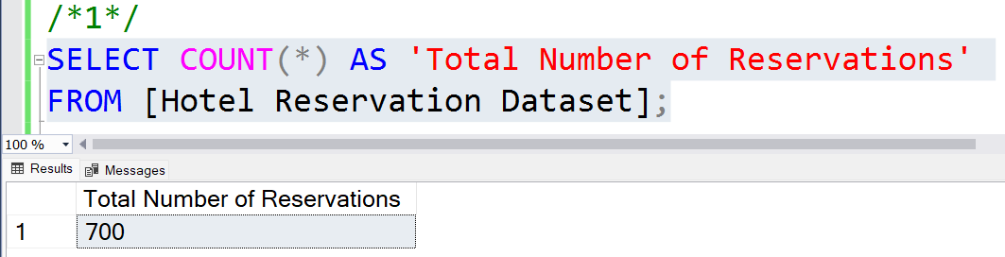
1. What is the total number of reservations in the dataset?

Slide 8
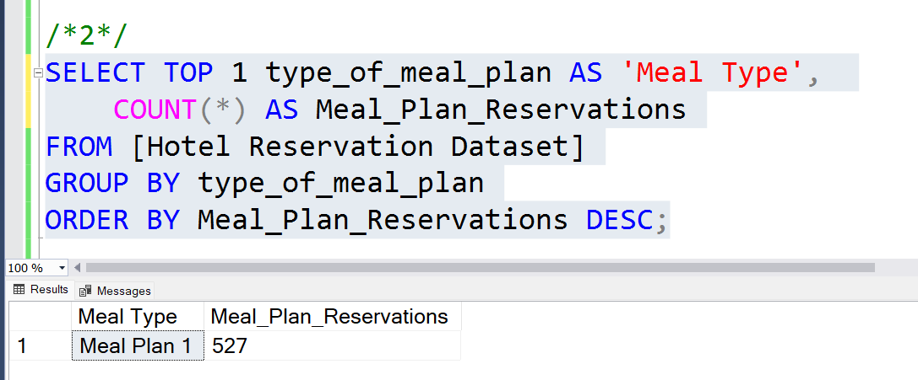
2. Which meal plan is the most popular among guests?

Slide 9
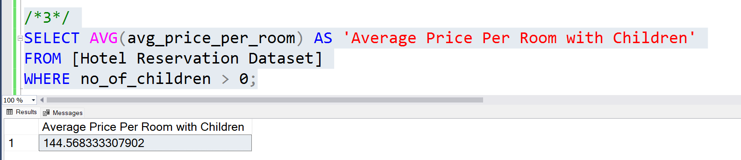
3. What is the average price per room for reservations involving children?

Slide 10
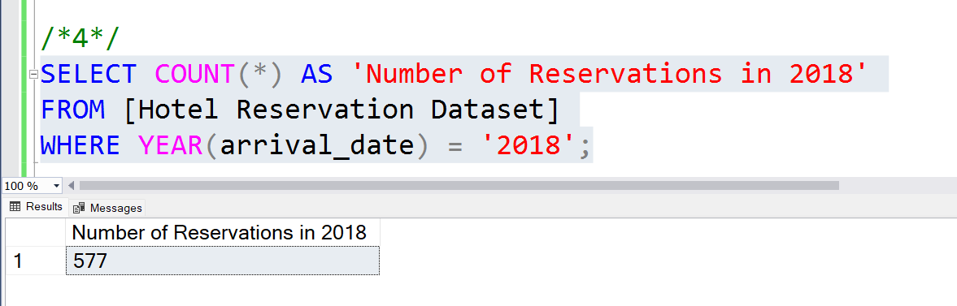
4. How many reservations were made for the year 20XX (replace XX with the desired year)?

Slide 11
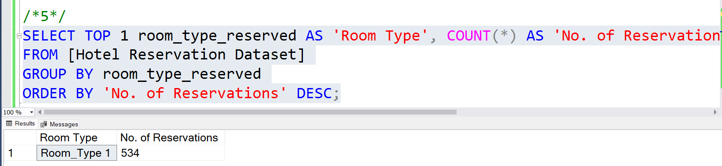
5. What is the most commonly booked room type?

Slide 12
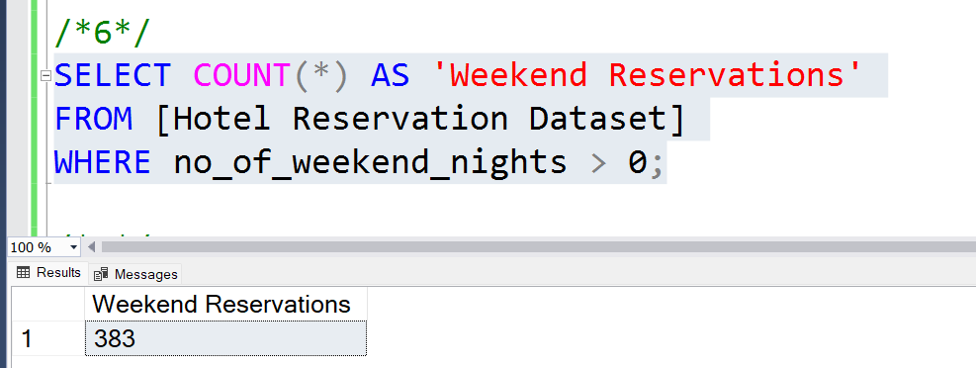
6. How many reservations fall on a weekend ?

Slide 13
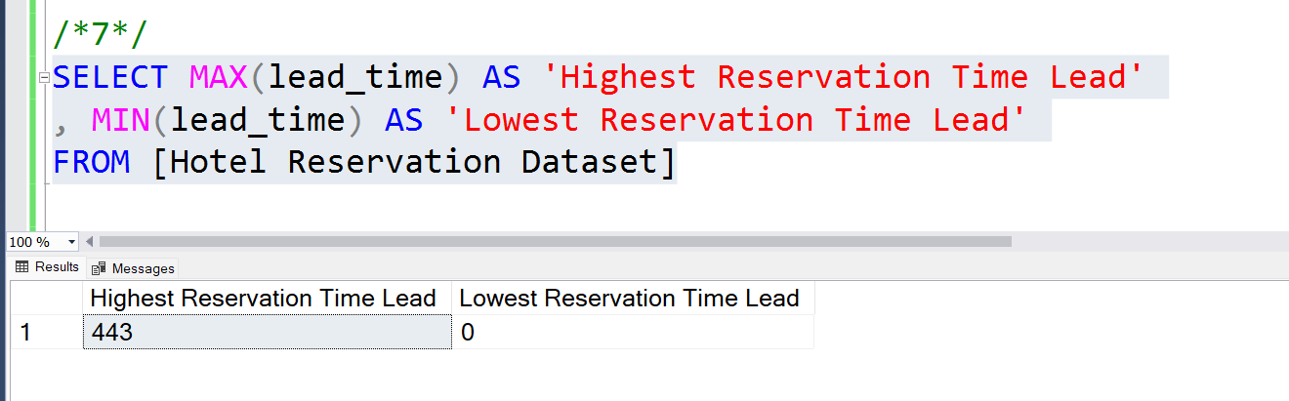
7. What is the highest and lowest lead time for reservations?

Slide 14
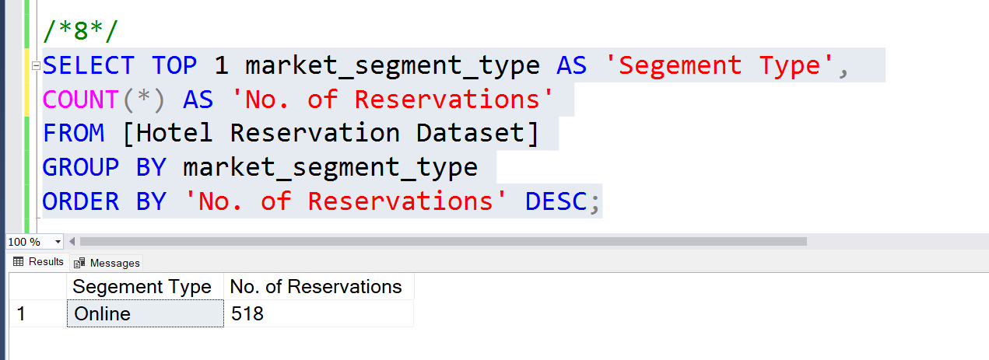
8. What is the most common market segment type for reservations?

Slide 15
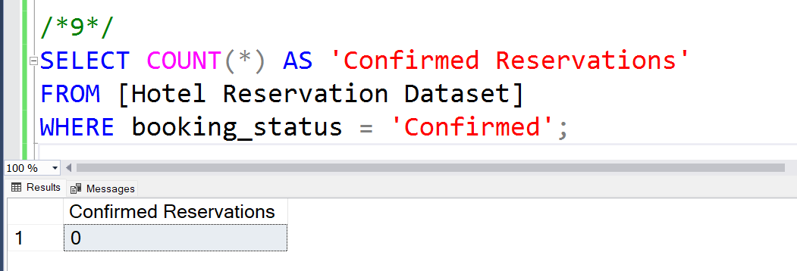
9. How many reservations have a booking status of "Confirmed"?

Slide 16
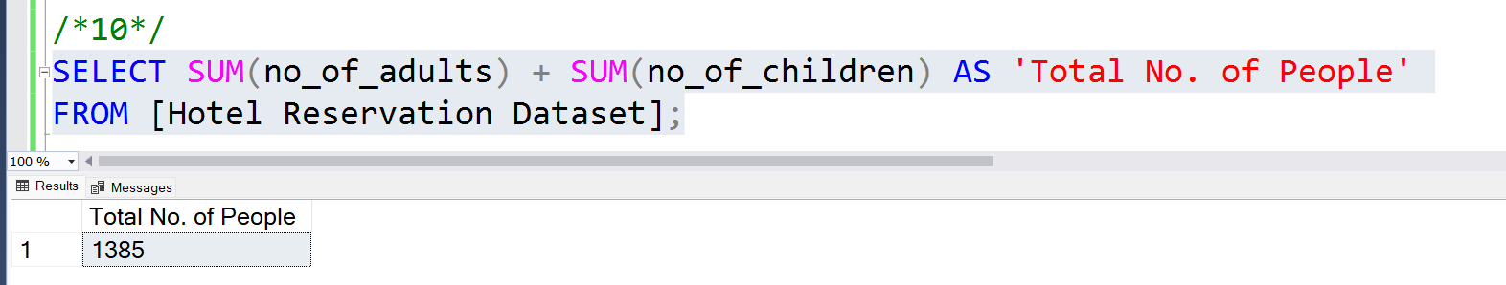
10. What is the total number of adults and children across all reservations?

Slide 17
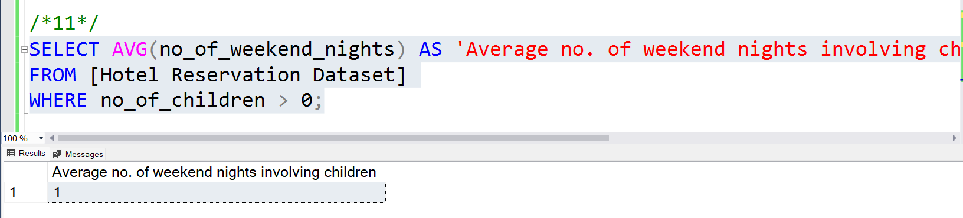
11. What is the average number of weekend nights for reservations involving children?

Slide 18
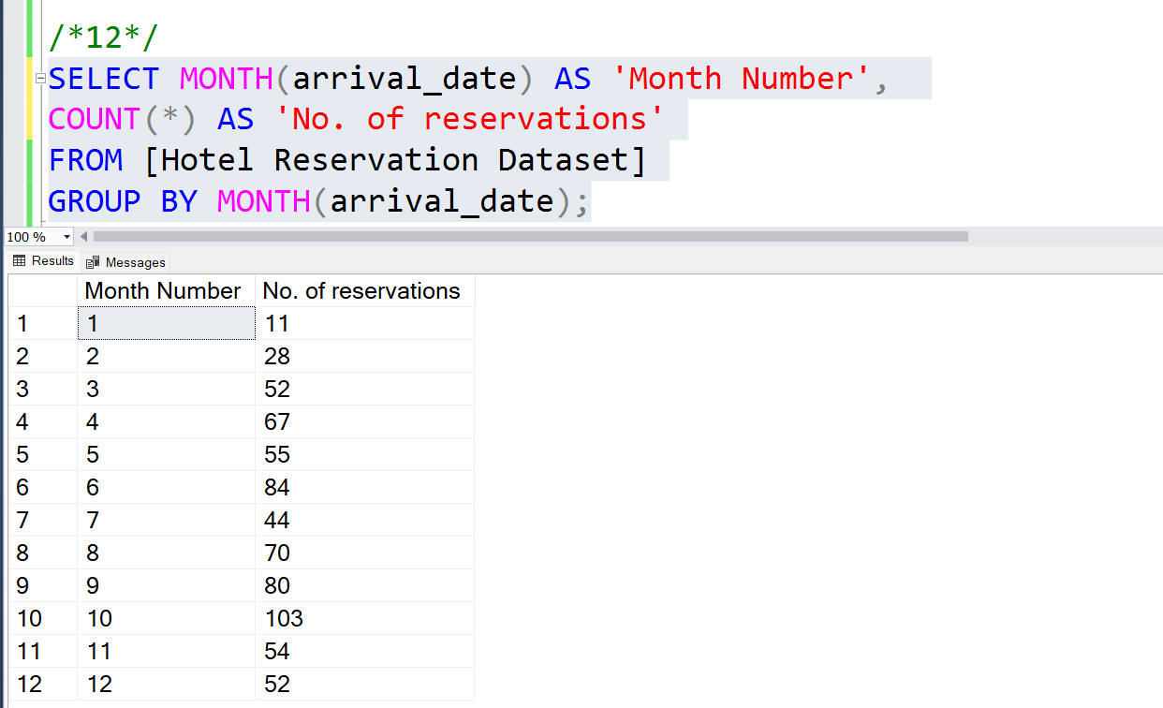
12. How many reservations were made in each month of the year?

Slide 19
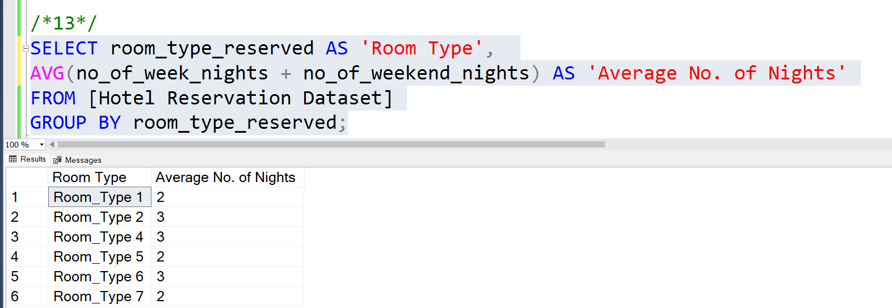
13. What is the average number of nights (both weekend and weekday) spent by guests for each room
type?

Slide 20
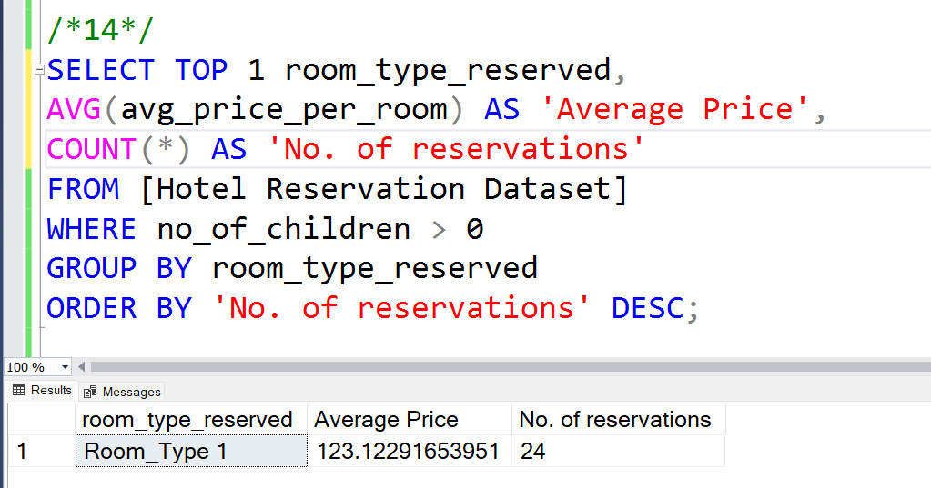
14. For reservations involving children, what is the most common room type, and what is the average price for that room type?

Slide 21
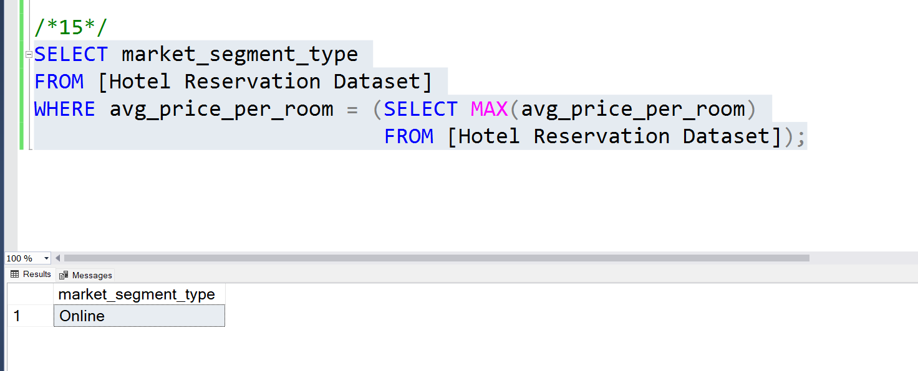
15. Find the market segment type that generates the highest average price per room.

Slide 22
Future Actions
With October being the busiest month, the hotel can consider adjusting pricing strategies or increasing marketing efforts during this peak period to maximize revenue.
Since the "Online" segment is both the most common and generates the highest average price per room, focusing marketing efforts and improving the booking experience for this segment could further enhance revenue.
Understanding the distribution of lead times can help in forecasting and managing inventory. Special promotions could be targeted at last-minute bookers or those booking far in advance.

Slide 23
Future Actions
The high number of weekend reservations suggests a need for strategic pricing or special weekend packages to attract more guests during weekdays and balance occupancy rates.
Investigating the reason behind 0 confirmed reservations is crucial. This could be due to a data collection issue or a business problem that needs to be addressed.
Given the significant number of reservations involving children and the average price per room, creating family-friendly packages or amenities could attract more family travelers.

